Slide 1



Problem Theme 2
Katalyst Chat-Bot
Team 14
Tisya Manhas
Anushree Gattani
Divyam Sharma
Viraj Mane
Kanad Kulkarni
Rutika Patil
Ridhi Shende
Nimrat Singh

Slide 2
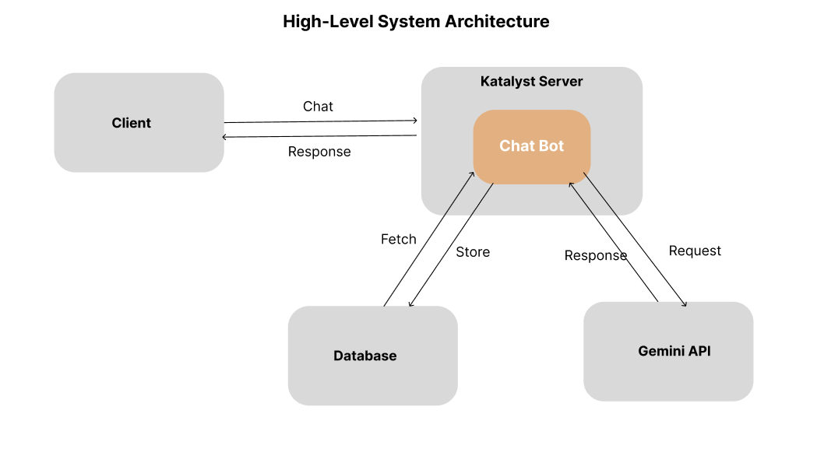
Solution Overview:
4
August 20, 2024

Slide 3
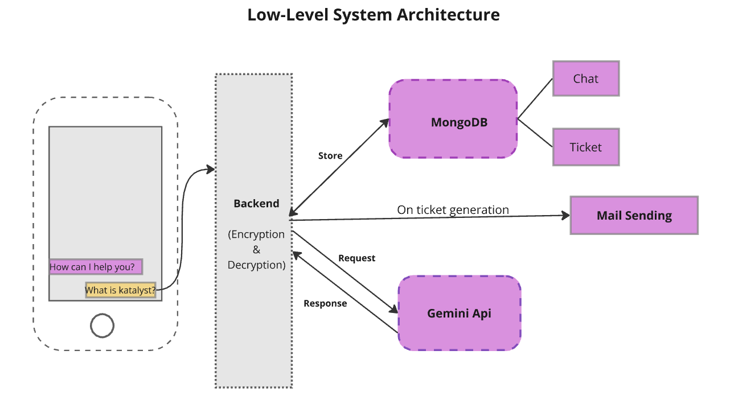
Solution Overview:
2
August 20, 2024

Slide 4
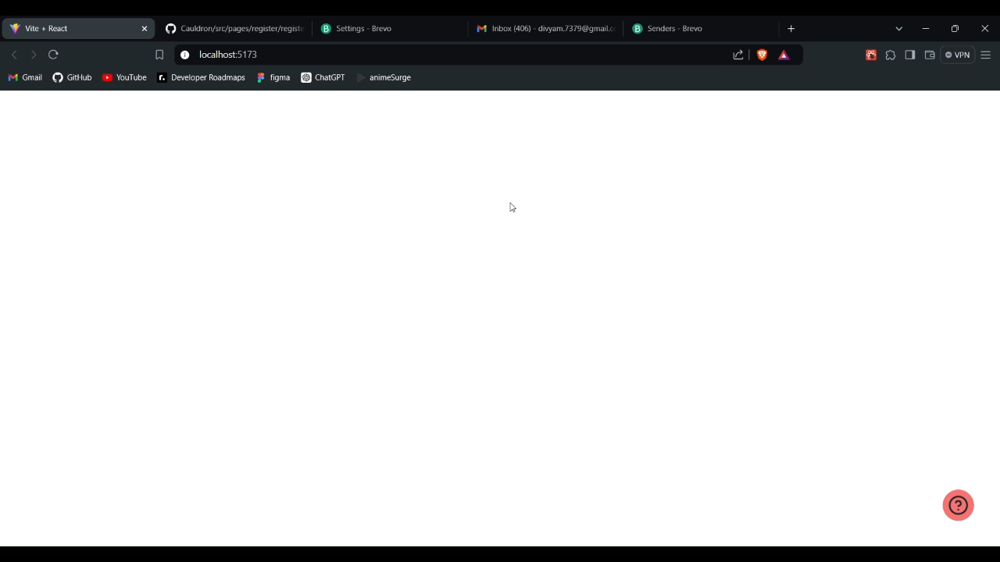
Demo Video
4
August 20, 2024

Slide 5
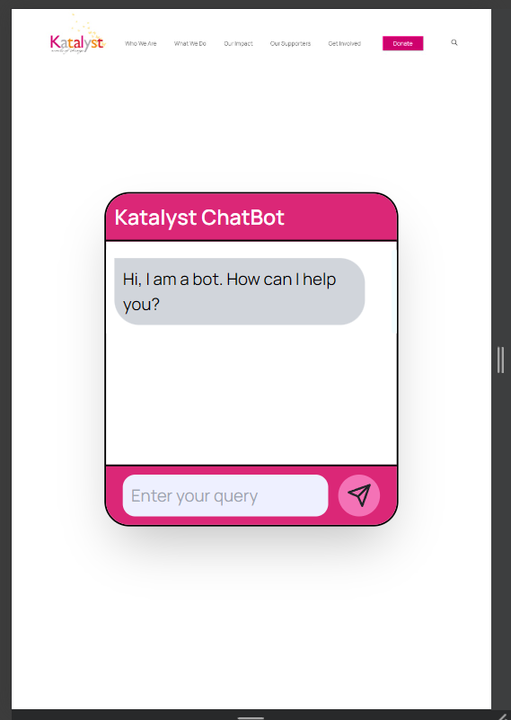
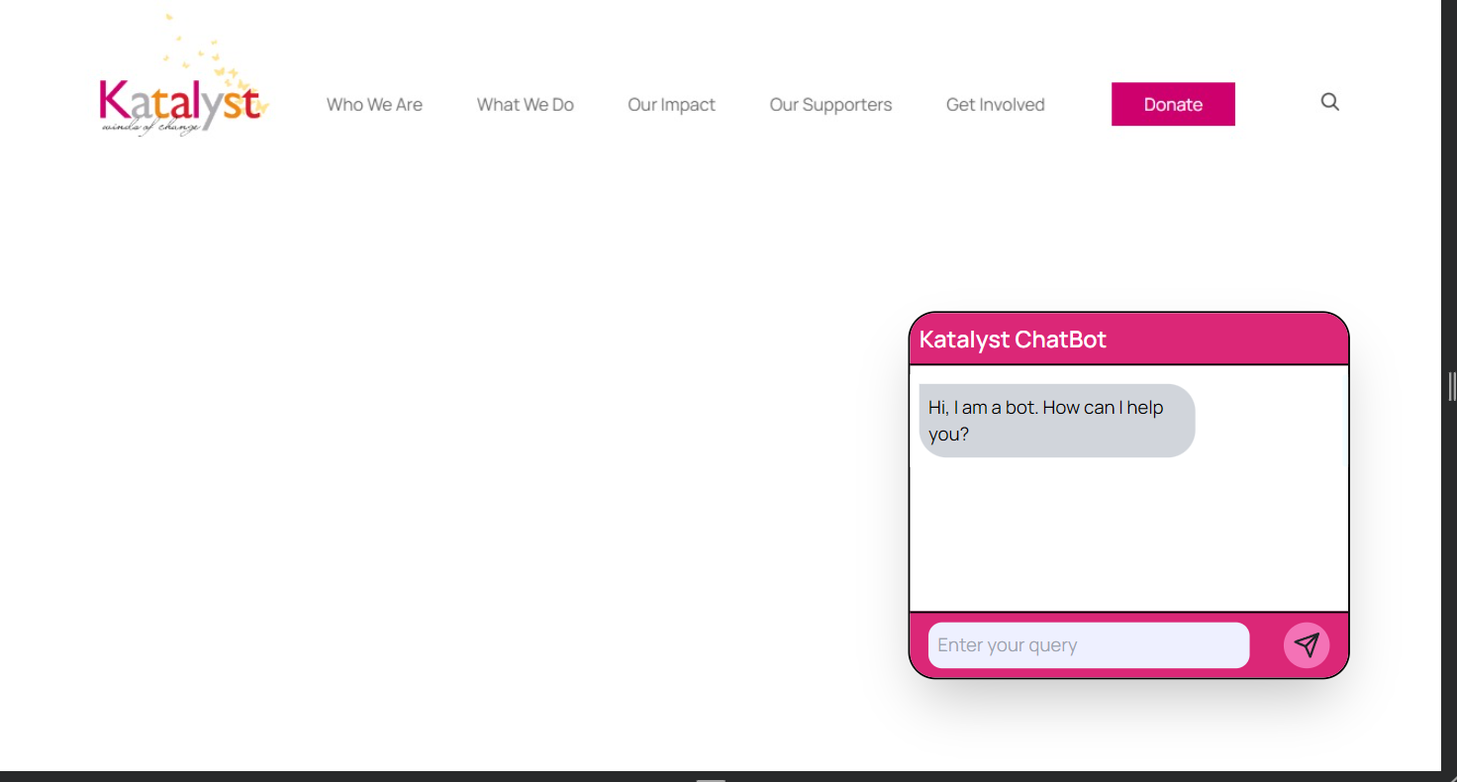
Responsive
4
August 20, 2024

Slide 6
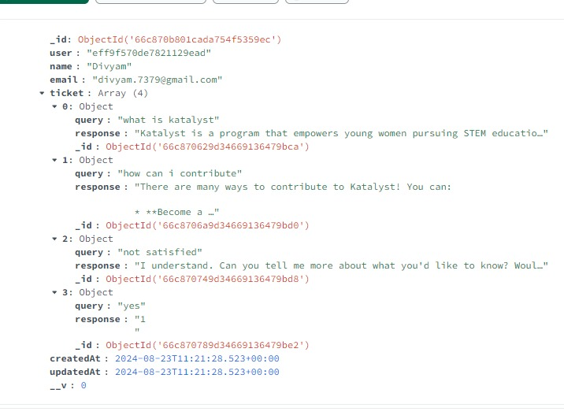
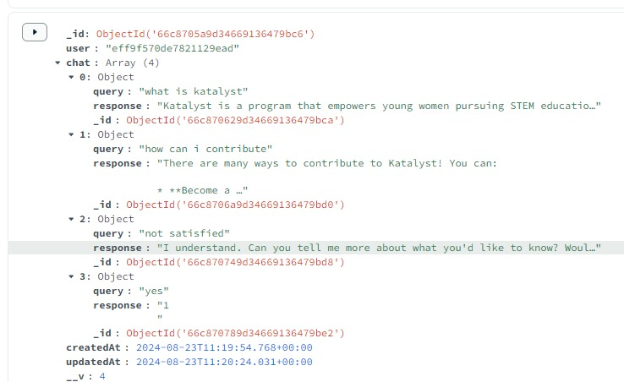
Database
4
August 20, 2024

Slide 7







Technology Stack
5
August 20, 2024

Slide 8
Future scope
Enhance the chatbot by allowing administrators to add frequently asked but previously unanswered queries to the system prompt. This will enable the bot to continually improve its response accuracy and coverage over time.
Incorporate generative AI to suggest probable questions as users type their queries. This feature will help preemptively address common questions and guide users to the most relevant information, improving the overall user experience.
Provide Image Recognition Support
Provide Voice Command Support
6
August 20, 2024

Slide 9
Q&A
7
August 20, 2024

